Slide 1

2D SHAPES
Maths
Grade 2

Slide 2
Objectives
In this lesson
Learners will learn about different types of shapes
They will also learn about their sides and points
They relate shapes to real life shapes

Slide 3
Different types of 2D Shapes
Khutlotharo
Sekwere
Khutlonne thwi
taaamane
lee
naledi
Sediko

Slide 4
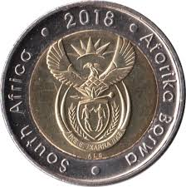
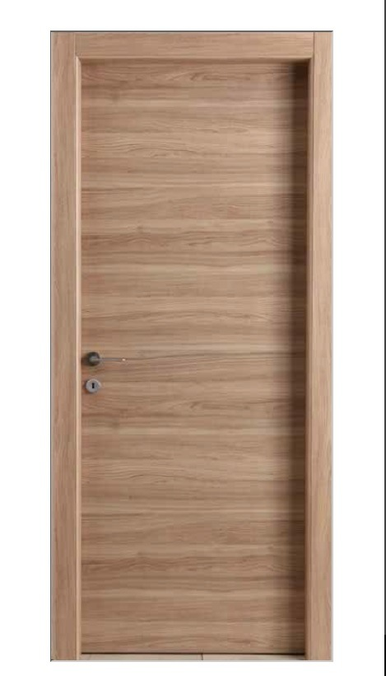


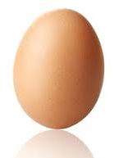
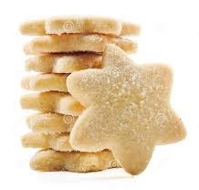


Lets look at shapes that we see everyday
sesupanako
khaete
khoini
Leswao la tsela
kuku
lebati
lee

Slide 5
Sebopego | mahalakore | dintlha | leina
 | 4 | 4 | taamane
 | 4 | 4 | khutlonnethwi
 | 0 | 0 | sediko
 | 3 | 3 | khutlotharo
 | 13 | 7 | naledi
 | 0 | 0 | lee
Lets check the following……
How many sides
How many Points
Can you name the shape?

Slide 6
Play time
Continue

Slide 7
Wrong Answer

Slide 8
Ke Sebopego sefe se?
Sekwere
lee
taamane

Slide 9
O kgonne

Slide 10
What shape is this?
Sekwere
lee
taamane

Slide 11
O kgonne

Slide 12
Ke Sebopego sefe se?
Khutlonne thwi
naledi
khutlotharo

Slide 13
O kgonne

Slide 14
Ke Sebopego sefe se?
lebati
kuku
sesupanako

Slide 15
O kgonne

Slide 16
Ke Sebopego sefe se?
lee
khaete
khoine

Slide 17
O kgonne

Slide 18
Ke Sebopego sefe se?
lee
sesupanako
khoini

Slide 19
O kgonne

Slide 20
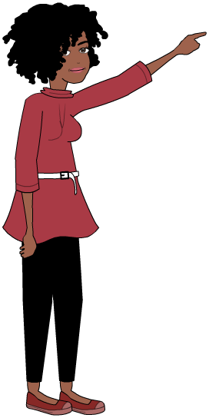
Ke a leboga
A re kopaneng gape

