Slide 1
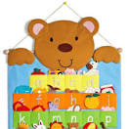
ABC LEARNING
WITH MOKHUDU MOJAPELO

Slide 2

Aa
apple

Slide 3

Bb
ball

Slide 4
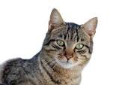
Cc
cat

Slide 5
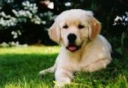
Dd
dog

Slide 6

Ee
egg

Slide 7

Ff
fire

Slide 8
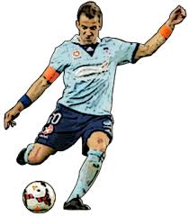
Kk
kick

Slide 9
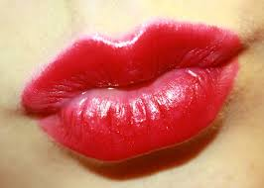
Ll
lips

Slide 10
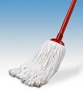
Mm
mop

Slide 11
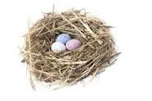
Nn
nest

Slide 12
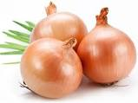
Oo
onions

Slide 13
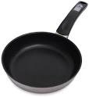
Pp
pan

Slide 14
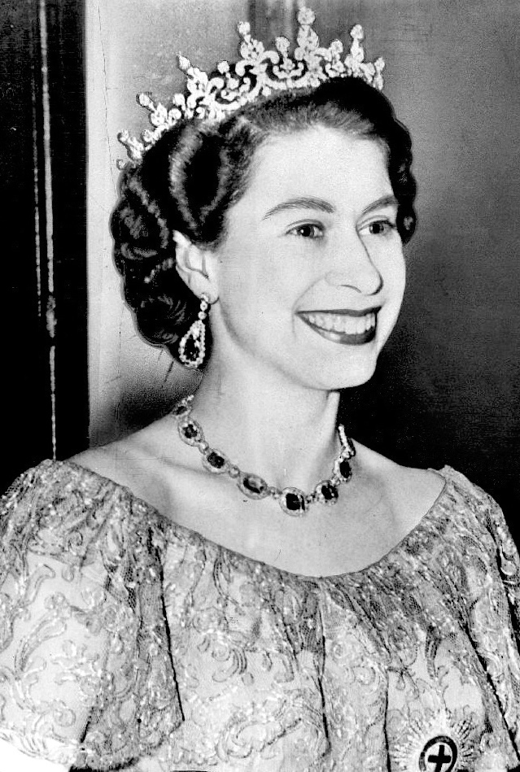
Qq
queen

Slide 15
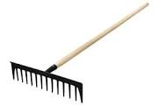
Rr
rake

Slide 16

Ss
sun

Slide 17
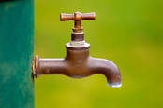
Tt
tap

Slide 18

Uu
umbrella

Slide 19
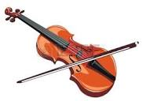
Vv
violin

Slide 20
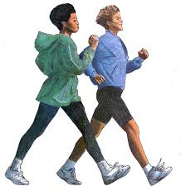
Ww
walk

Slide 21
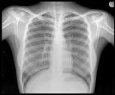
Xx
x-ray

Slide 22

Yy
yoyo

Slide 23

Zz
zip

