Slide 1

Technology in the Classroom: Empowering Learners
Enhancing Engagement, Personalization, and 21st-Century Skills
Presenter: Mokhudu Mojapelo

Slide 2

Enhanced Engagement & Interactivity
Interactive whiteboards, educational software, and online quizzes
Gamified learning experiences and virtual simulations
Increased student participation and collaboration
Bringing Learning to Life

Slide 3
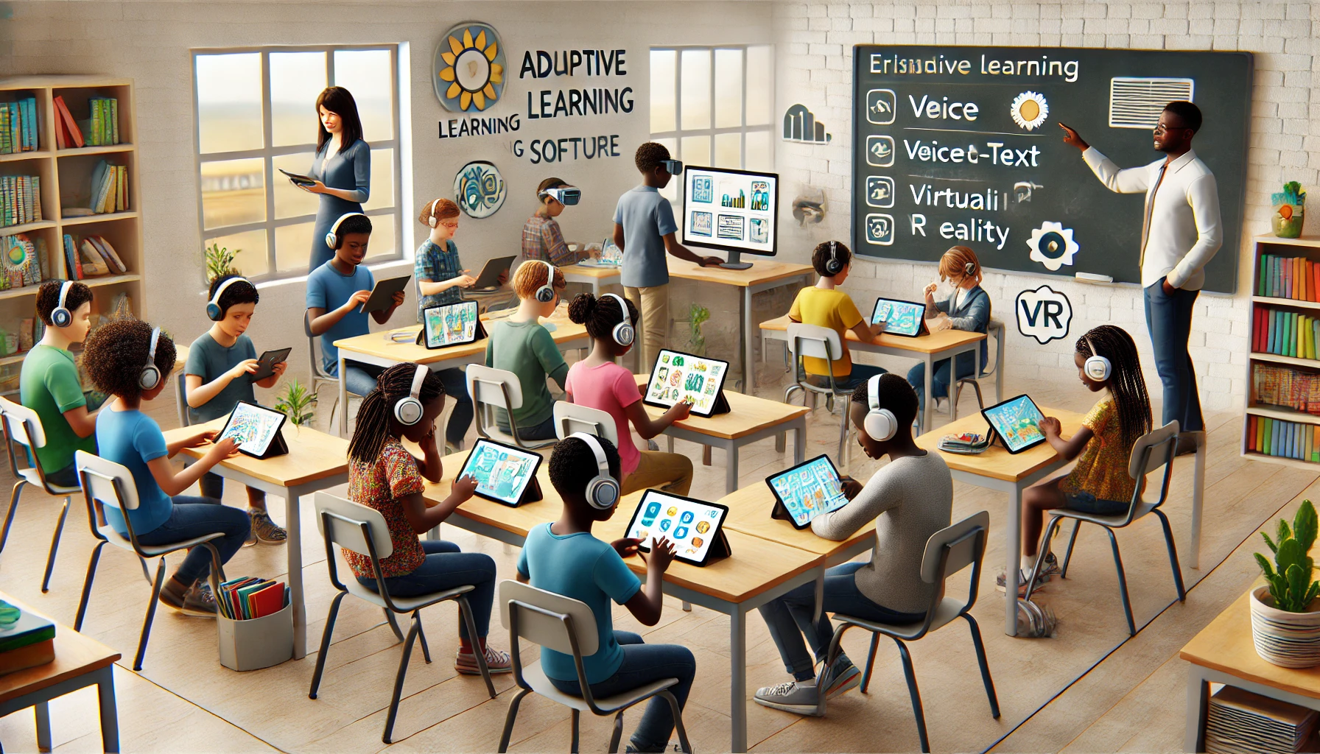
Personalized Learning
Tailoring Education to Individual Needs
Adaptive learning platforms and customized learning paths
Differentiated instruction and self-paced learning
Catering to diverse learning styles and abilities

Slide 4
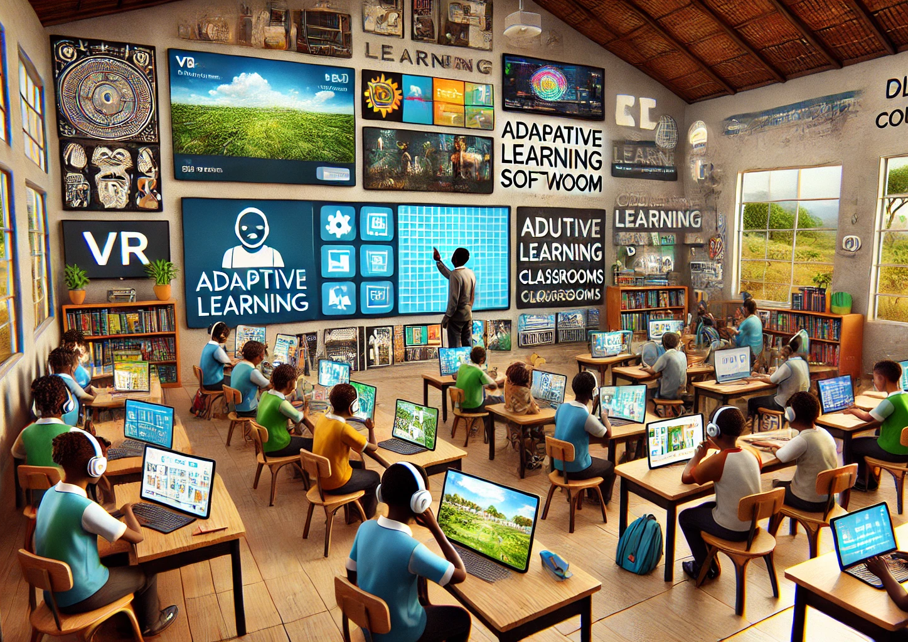
Access to a Wider Range of Resources
Online libraries, educational videos, and virtual field trips
Access to experts and global perspectives
Fostering curiosity and a love of learning

Slide 5
Developing 21st-Century Skills
Preparing Students for the Future
Critical thinking, problem-solving, and creativity
Collaboration, communication, and digital literacy
Technology integration as a foundational skill

Slide 6
Improved Communication & Collaboration
Online forums, group projects, and video conferencing
Fostering a sense of community and shared learning and sharing on social media
Building essential communication and teamwork skills by creating blogs

Slide 7
Increased Accessibility & Flexibility
Breaking Down Barriers
01
Online learning platforms and educational apps
02
Catering to students with diverse needs and learning preferences
03
Flexible learning options for students with unique circumstances
04

Slide 8
Preparing Students for the Future
Technology integration as a key to future career success
Preparing students for a technology-driven world
Bridging the gap between education and the workplace

Slide 9
Addressing Concerns & Implementing Best Practices.
Balancing technology use with traditional teaching methods
1
Ensuring equitable access and digital equity
2
Promoting responsible online behavior and digital citizenship
3

Slide 10
Conclusion: Embracing Technology for a Brighter Future
Technology as a powerful tool for enhancing teaching and learning
Embracing innovation and continuous improvement
Empowering students to thrive in a digital age
A call for action

