Slide 1



Assessing Learning in a Digital Age: Enhancing Outcomes Through Online Methods
Mokhudu Mojapelo (Departmental Head)
Ngwanamago Primary school

Slide 2

What is digital assessment
The use of digital tools to evaluate student learning.

Slide 3

The Evolving Educational Landscape
Education is undergoing a rapid transformation, driven by technological advancements, shifting pedagogical strategies, and changing learner needs

Slide 4
Link
https://share.synthesia.io/9af30a7e-b870-4875-ba3f-4d473ccee67d

Slide 5
Transformation from traditional to digital learning assessment
Traditional: Paper-based tests, face-to-face evaluations.
Digital: Online quizzes, adaptive tests, gamified assessments.
Key Differences: Speed, scalability, and interactivity.

Slide 6
TYPES OF DIGITAL ASSESSMENTS
Formative: Ongoing feedback (e.g., Kahoot, Google Forms, Quizzes, Flipgrid etc ).
Summative: Final evaluations (e.g., online exams, portfolios).
Peer & Self-Assessment: Collaborative learning approaches.

Slide 7
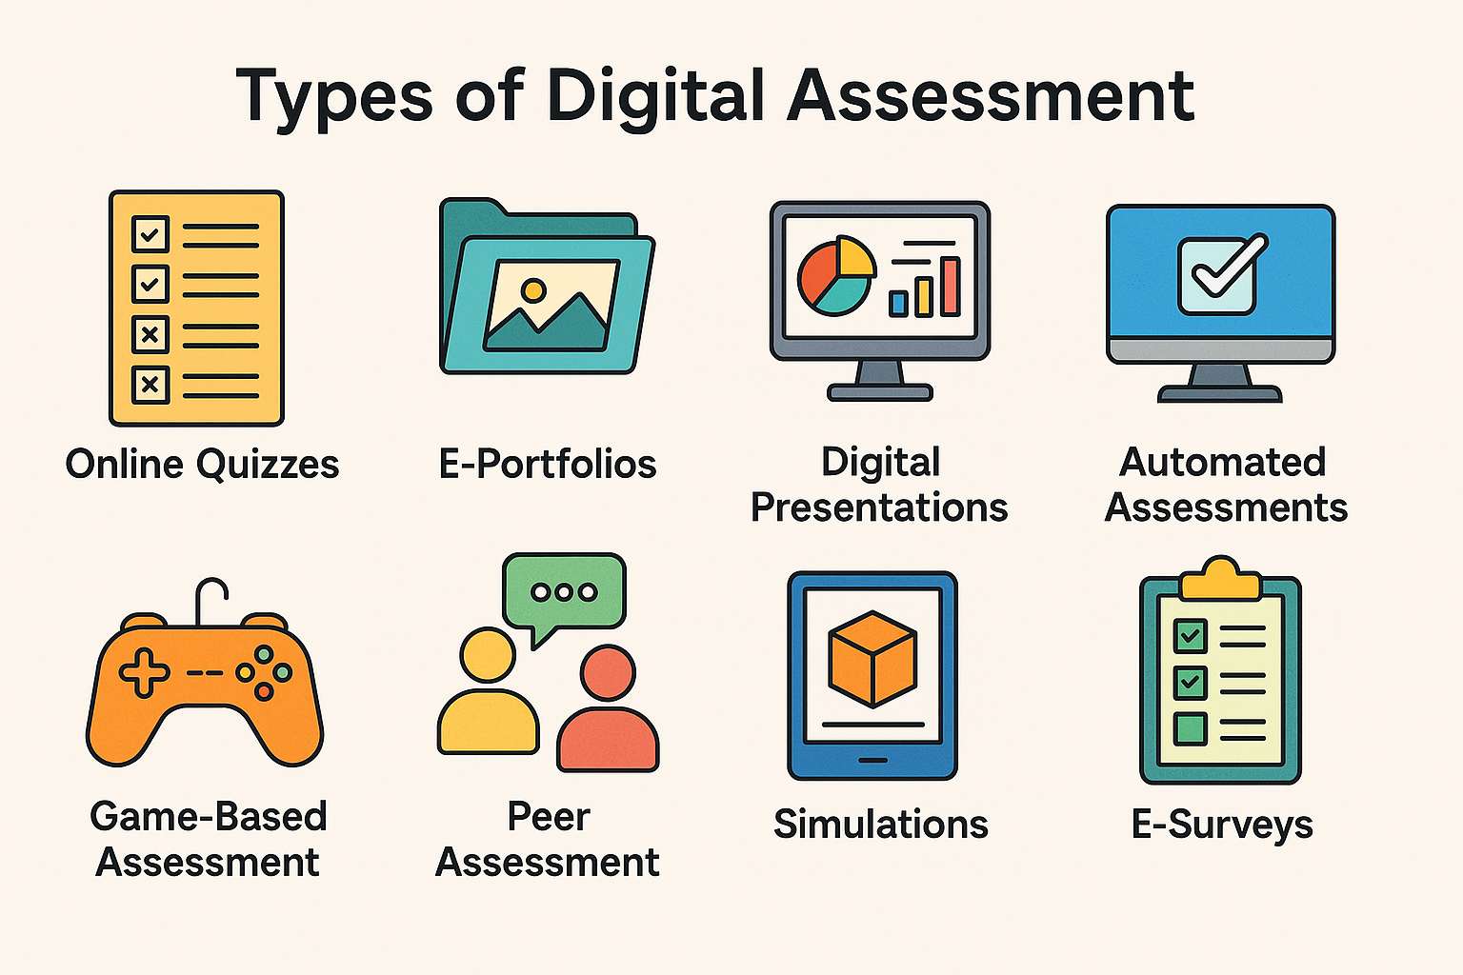
Assessment types

Slide 8
Advantages of digital assessment
Immediate feedback for learners.
Personalized learning experiences.
Scalability for large groups.
Integration with data analytics.

Slide 9
Challenges of digital assessment
Digital divide: Access to technology.
01
Academic integrity: Cheating concerns.
02
Technical issues: Connectivity and platform reliability.
03
Need for digital literacy.
04

Slide 10
Technologies supporting digital assessments
AI-driven adaptive testing.
Learning Management Systems (LMS).
Gamification and simulations.
Data-driven feedback mechanisms.

Slide 11

Link Online digital assessment
https://kahoot.it/challenge/05069640?challenge-id=d8b09521-1c3c-4c10-9442-cf42e8d20cd0_1743507631212
05069640

Slide 12
Best Practices of digital assessment
Align assessments with learning objectives.
1
Provide clear guidelines and rubrics.
2
Utilize a mix of assessment types.
3
Ensure accessibility and inclusivity.
4

Slide 13
The importance of effective assessment in the digital era
Ensures accurate measurement of learning outcomes.
Helps personalize instruction and address learning gaps.
Provides real-time feedback for continuous improvement.
Enhances engagement through interactive assessment tools.
Supports data-driven decision-making in education.

Slide 14
Data driven decision making
Tracking
Tracking student progress.
Identifying
Identifying learning gaps.
Informing
Informing teaching strategies.
Enhancing
Enhancing personalized learning.

Slide 15

Thank you

