Slide 1
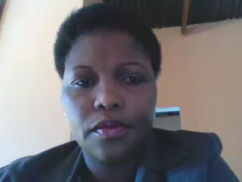
How to make spelling video
By Mokhudu MOJAPELO
From south Africa in limpopo

Slide 2
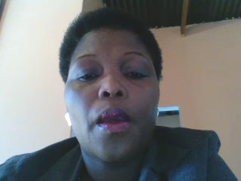
Why spelling videos
Learners can design this videos to revise their language structure
It helps them improve their vocabulary
Visuals improve their memory to recall what they have learned
It helps them understand words better by relating to pictures

Slide 3
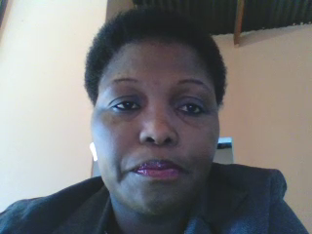
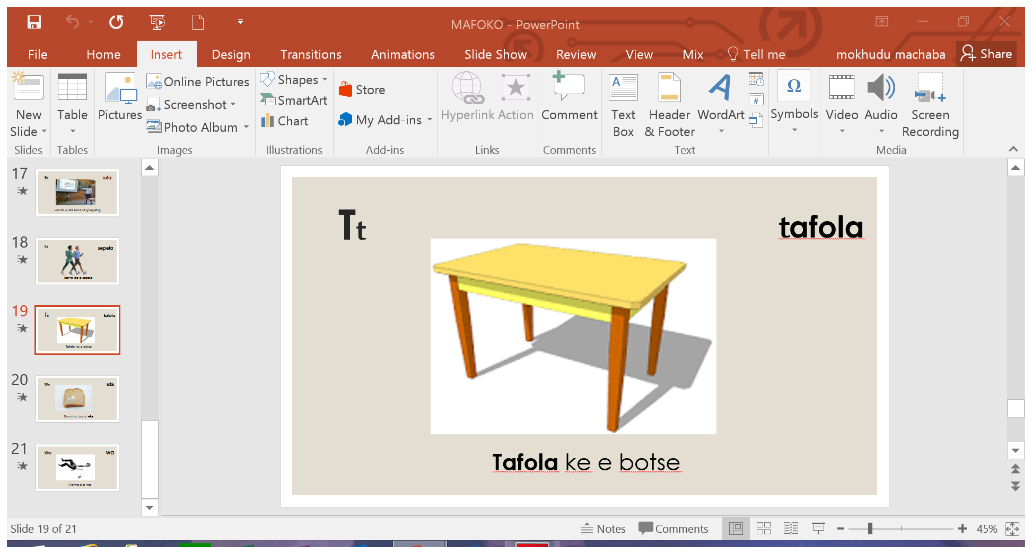
Help the learners select pictures and name them and create sentences with it

Slide 4
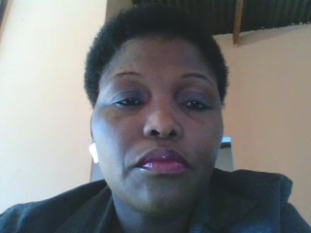
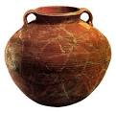
Pp
pitša
Re dira mageu ka gare ga pitša

Slide 5
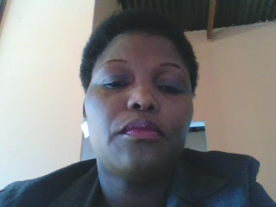
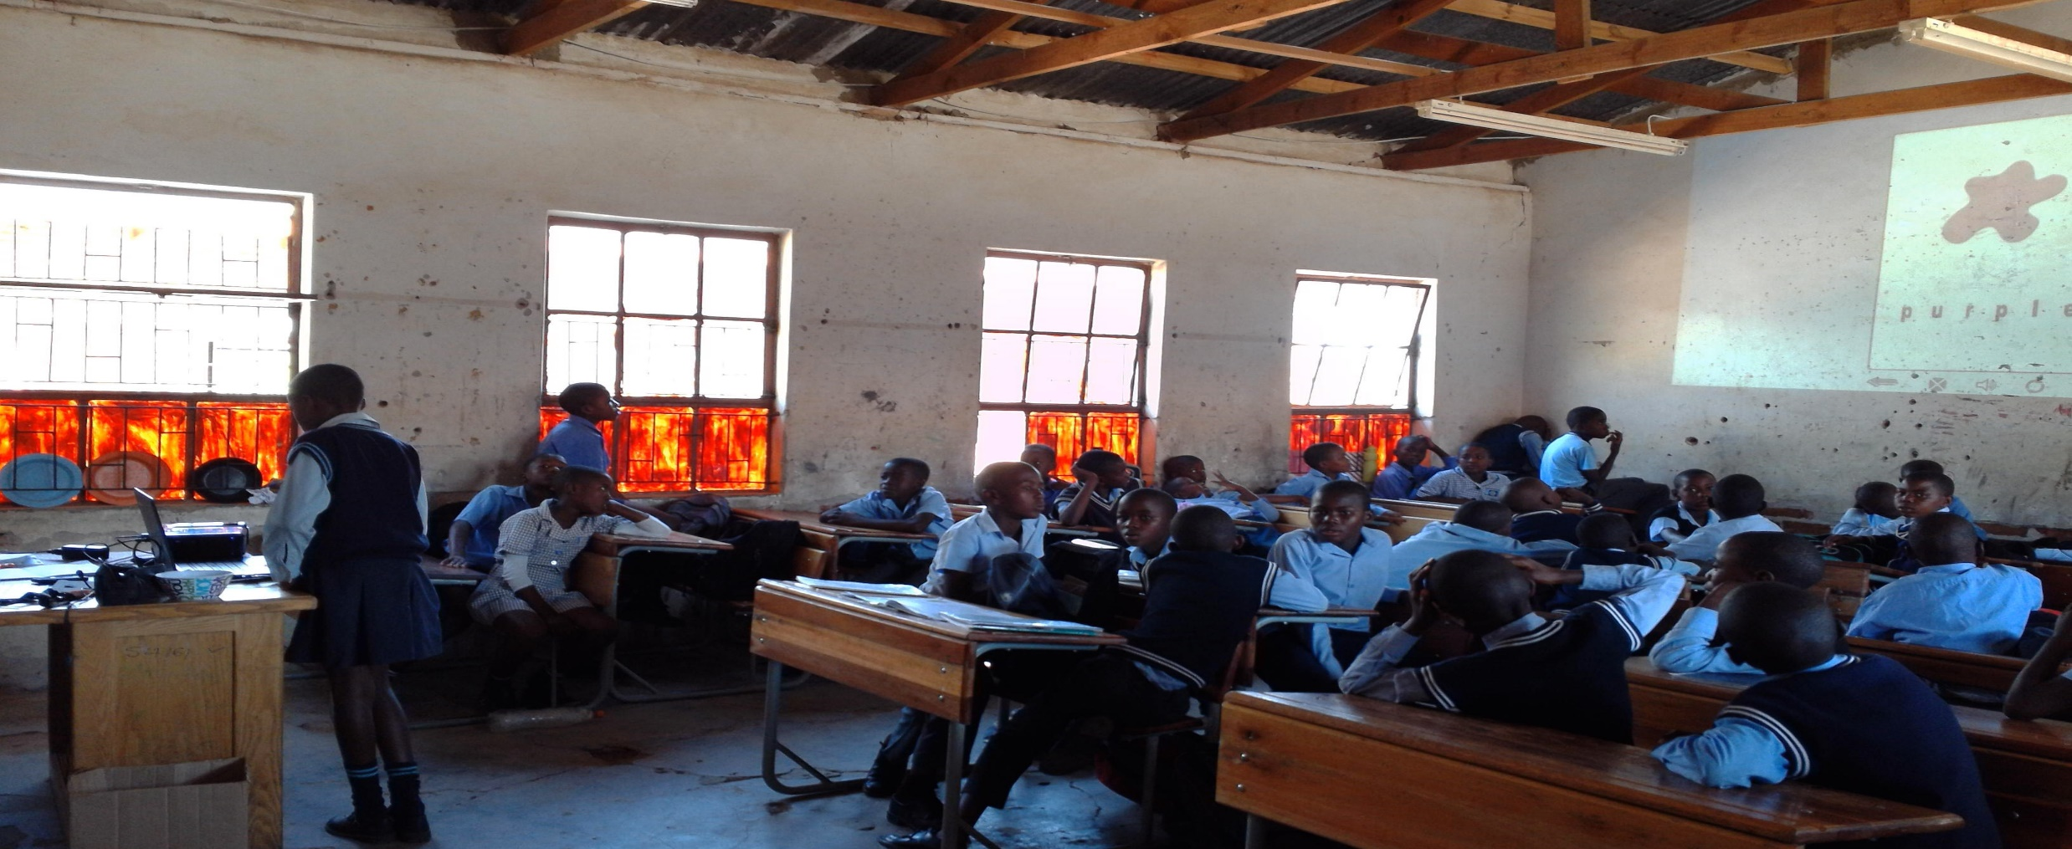
Learners practising the spelling activity

Slide 6
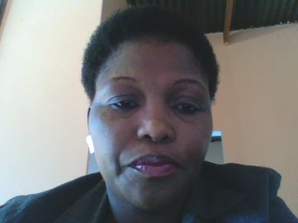
The Process
After coming up with words, pictures and creating sentences learners will record themselves saying words and coming up with sentences
They can use either Sepedi or English
They will then rehearse what they have created

Slide 7
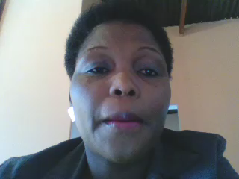
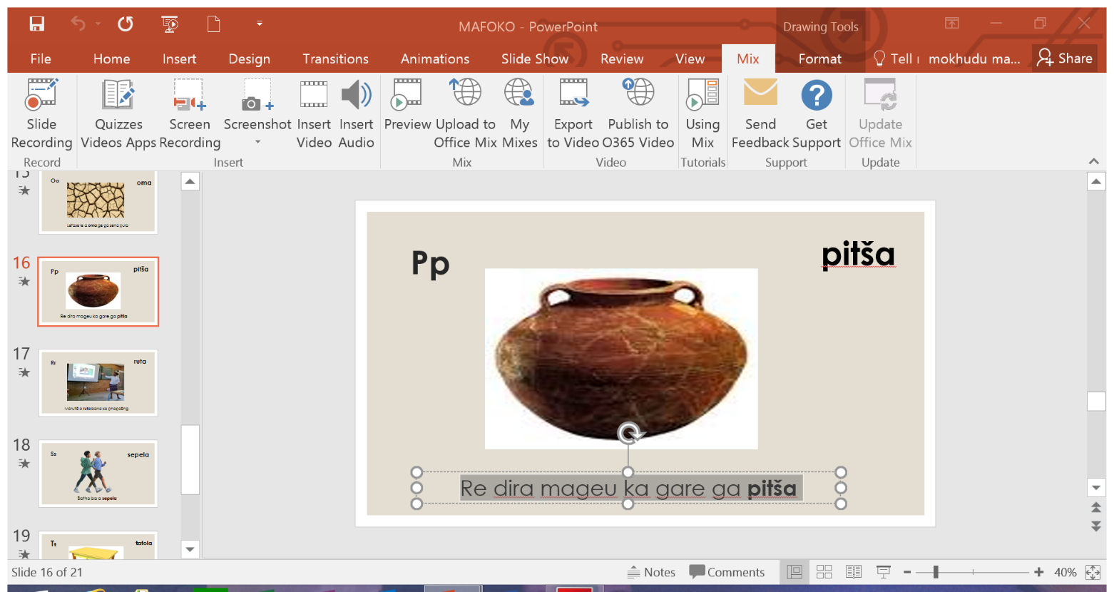
Creating the video

Slide 8
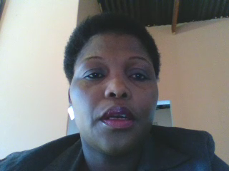
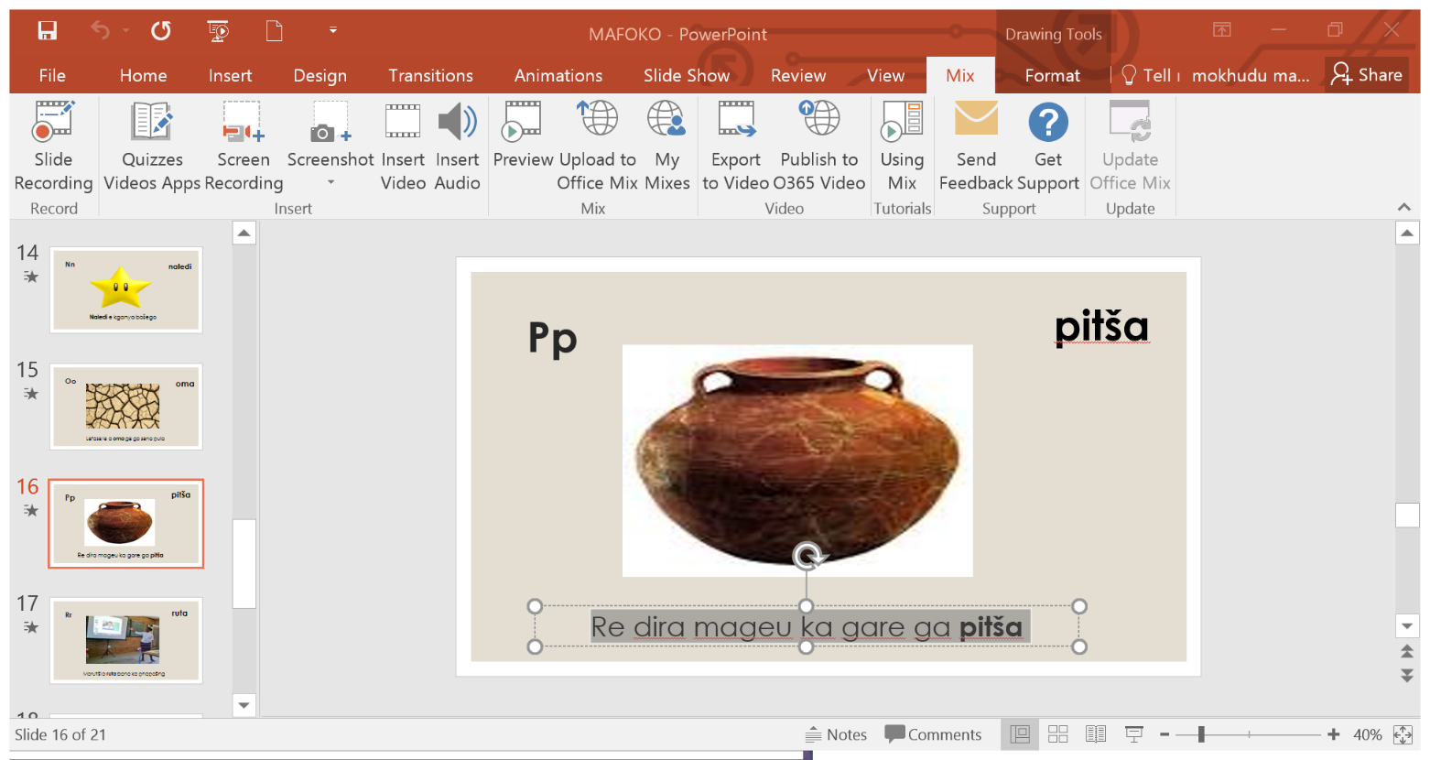
The next step will be to export to video

Slide 9
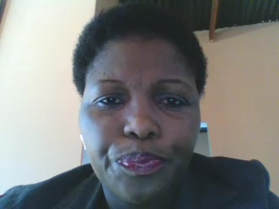
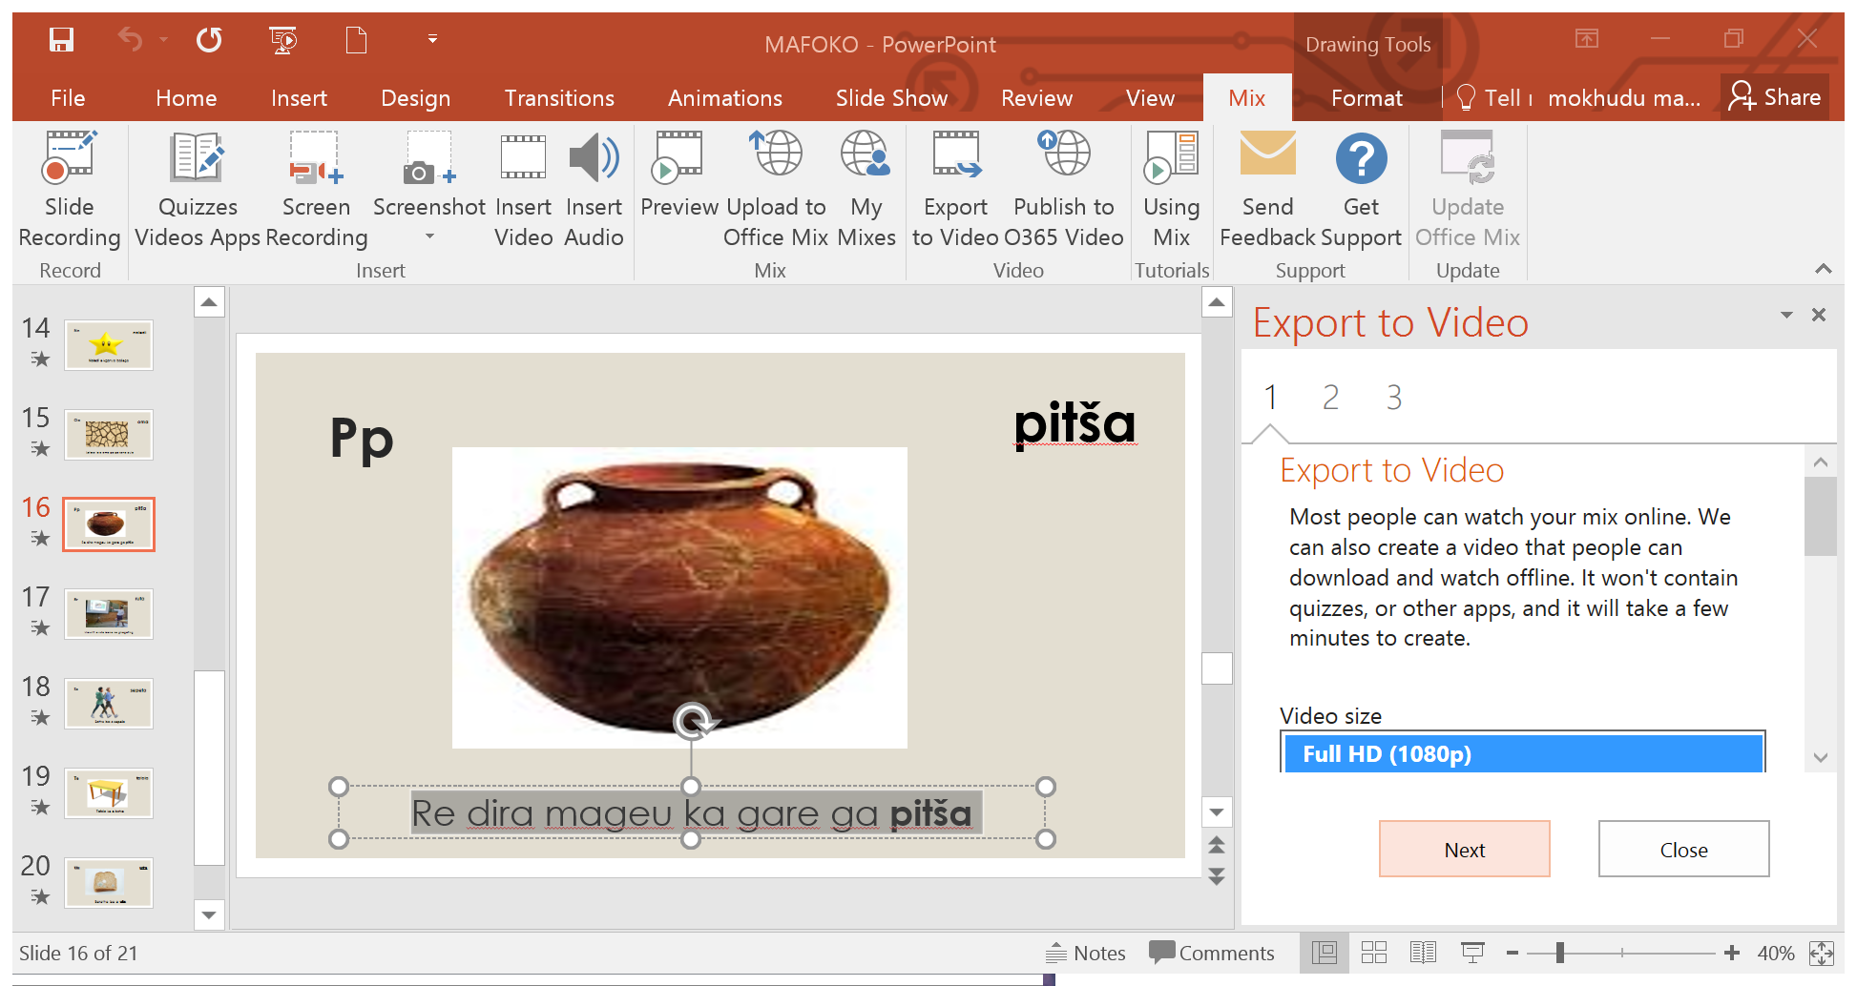
The next step

Slide 10
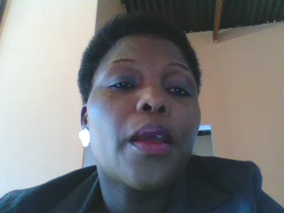
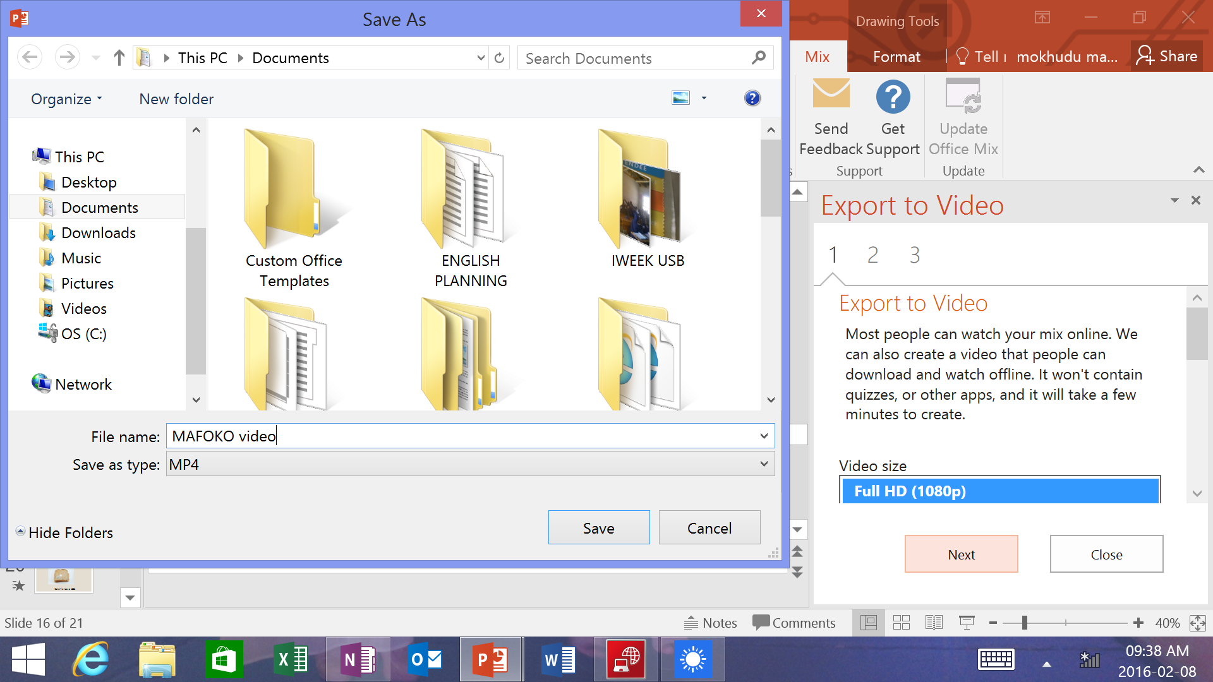
Clicking the next step will prompt you to save your video

Slide 11
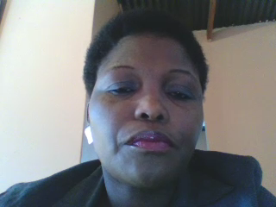
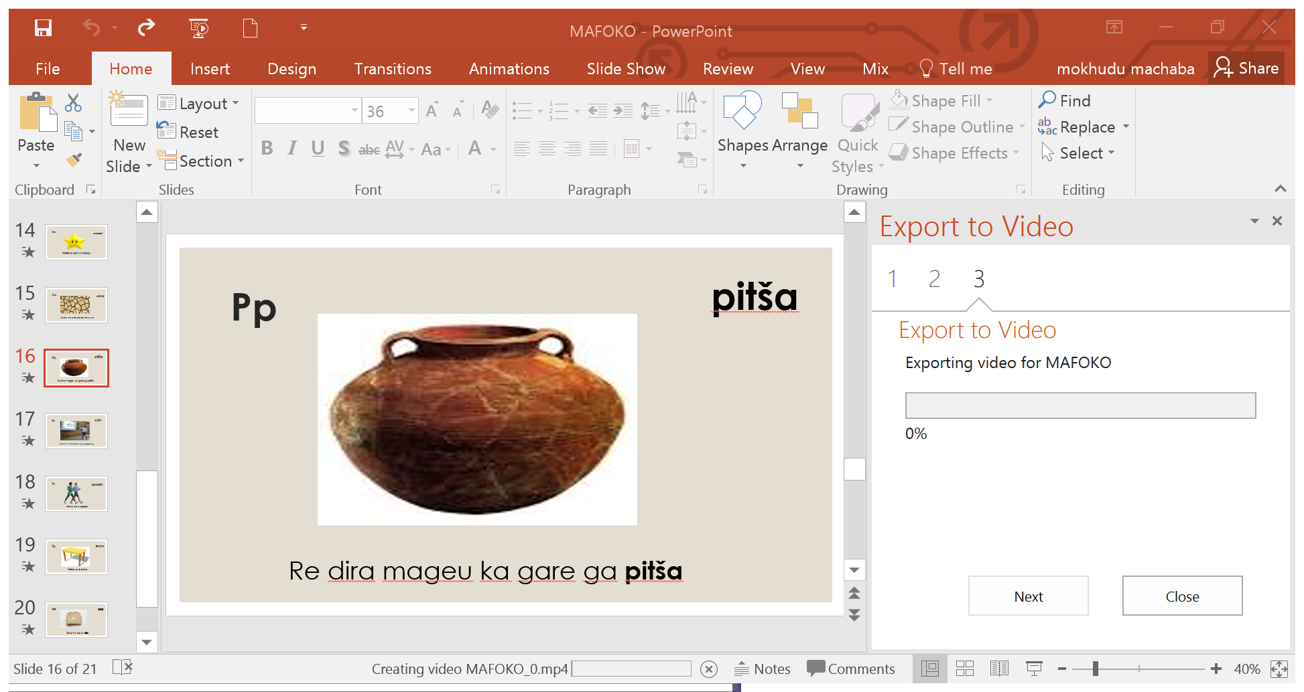
Exporting the video

Slide 12
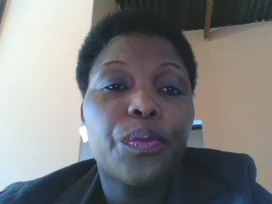
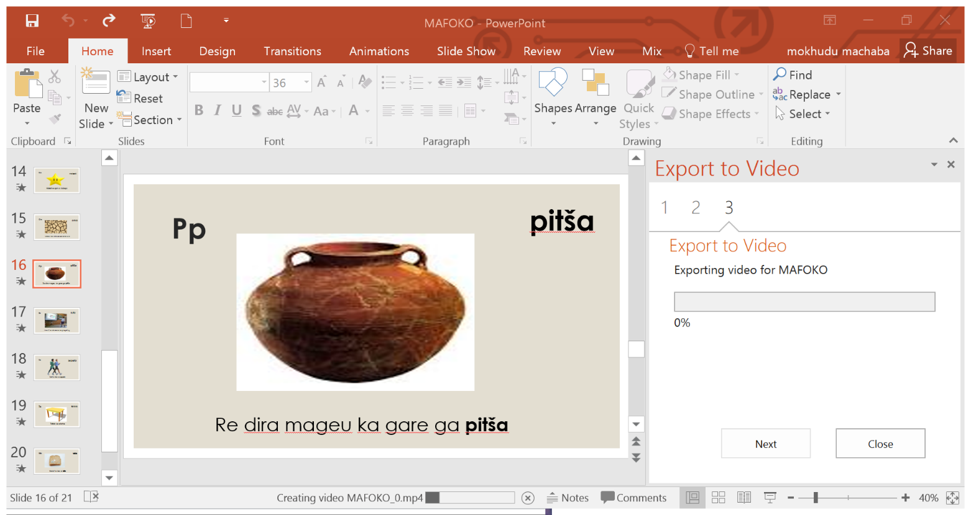
This will be an mp4 video

Slide 13
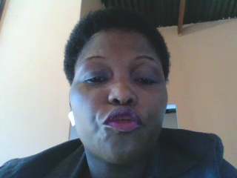
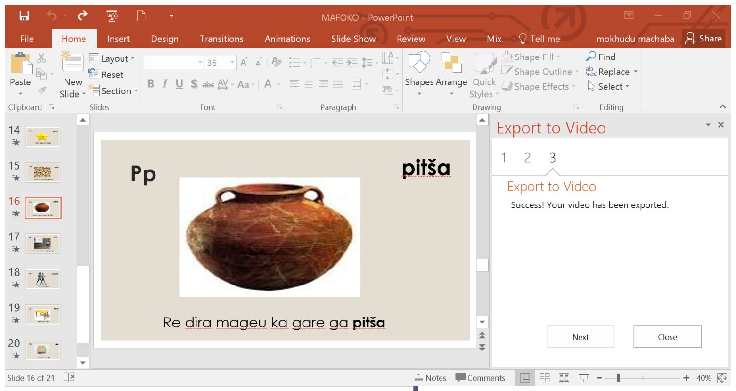

Slide 14
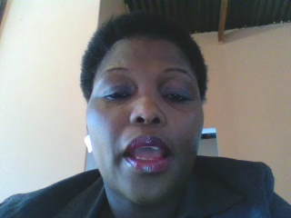
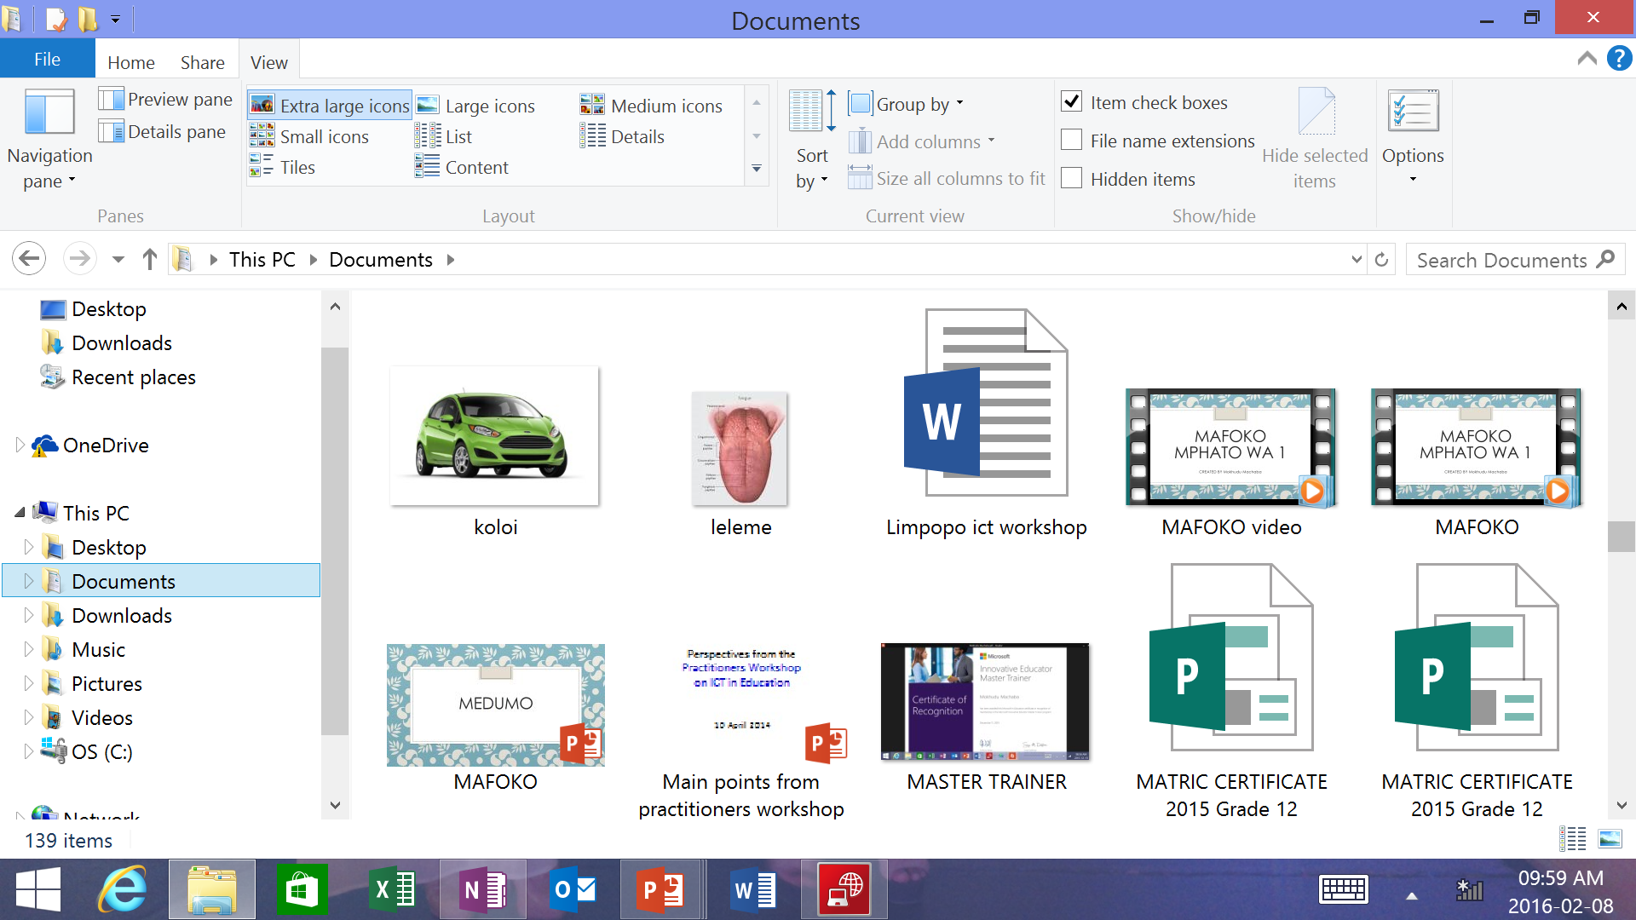
Your video will be ready for viewing in the destination that you have saved it

Slide 15
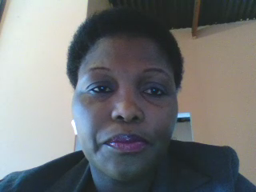
The video will be ready for viewing
You can share this presentation on Office Mix
You can upload to Youtube as well
You can upload to OneDrive
You can as well share it on your social networks like Facebook and Twitter

Slide 16
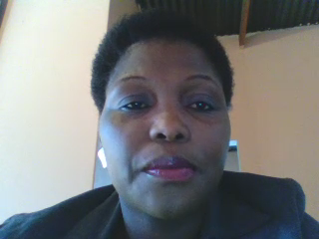
Conclusion
This has been a great tool for my language lessons

