Slide 1
SCHOOLNETSA CONFERENCE FREESTATE UNIVERSITY
ICT LEADERSHIP IN SCHOOLS
Mokhudu Mojapelo

Slide 2
Mokhudu machaba from ngwanamago primary school
Email: teblesmo@yahoo.com
Follow me on twitter @teblesmo
Face book: mokhudu machaba
Diigo: Mokhudu Machaba
LinkedIn: Mokhudu Machaba
Edmodo: Mokhudu Machaba
Slide share: Mokhudu Machaba

Slide 3
What is ICT
Information
And
Communication
Technology

Slide 4
SUCCESS OF THE SCHOOL
The effective success of the school is based on the adaptation of reforms.
The government stake holders must acknowledge the pedagogical use of ICT and be prepared to lead this reforms.
If the above can acknowledge the change, it will then influence teachers, motivate and make them be willing to adapt to change.
This will at the end be beneficial to the learners and the community as a whole.

Slide 5
SUCCESS CONTINUES
Principals should effectively take the lead in adapting to this change because they are first in charge in schools.
Principals who are inspirational and willing to learn through ICT becomes a role model.
As there is a rapid change in ICT there is a great need in in-service training of the teachers by the department.

Slide 6
BUYING EQUIPMENTS FOR ICT AT SCHOOL
The school has to get the proper specification of the equipment they need. E.g. Size of the hard drive, the speed of the processor, the software's and so on
Many times schools buy computer equipments because someone came to sell to them. They do not know specification on the computer and so on.
At the end of the day you find computer labs being white elephants because they are not competent with the programs they are using with the learners.
The school must have an adviser whenever it has to buy equipments or they have to consult with the relevant people

Slide 7


Slide 8
BUDGET PROCESS AND ITS POLICY
PLANNING (FINANCIAL)
IMPLEMENTATION
ASSESSMENT
QUALITY PRINCIPLES
CURRICULUM OUTCOMES
EFFECTIVE TEACHING AND LEARNING
EFFICIENCY/ SECURITY
CONTINUOS IMPROVEMENT
INSERVICE TRAINING
MAINTENANCE

Slide 9
ICT POLICY DEVELOPMENT CYCLE
CONSENSUS
POLICY TEAM
DEVELOP POLICY
VALIDATE POLICY
ADOPT AND COMMUNICATE
AUDIT
EVALUATE
REVIEW AND REVISE

Slide 10
WHO MUST BE INVOLVED IN POLICY MAKING
STAFF
PARENTS
MANAGEMENT

Slide 11
ME AS AN ICT LEADER AT SCHOOL
I developed the love of ICT after we got training from Avuxeni computer academy in collaboration with Netday, Uniforum, Coza Cares and ISPA.
That was in 2009, we did projects and I got nominated for the 10 finalists for Super Teacher Award. I was the runner – up and was awarded a laptop.
In 2010 I could not do anything since the management of the school could not understand any language I spoke on ICT.

Slide 12
CONTINUES.......
With RNR in 2011 I volunteered to leave the school and went to the present school I am working now.
Coza Cares sponsored us again to attend the conference in St. John’s College the same year (2011). And that ignited in me the passion I always had of ICT.
As a junior teacher at my present school, I still find it difficult to work on ICT, getting resources to work with the learners and just to be heared whenever I make suggestions on ICT.

Slide 13
Initiated projects at school
In 2011 we did the Marula project with learners where I involved community members. (Social Sciences, NS % Tech, A%C. ..\PERSONAL\THE STATE OF ENVIRONMENT AT OUR SCHOOL.pptx. This project we also competed at the Dept of Environmental and our school was a new comer there and we got position 6 out of 25 schools. We are looking forward to make this project a standing one were we have spoken to the municipality to adopt us. ../../Pictures/Auto Collage/marula_AutoCollage%202011.jpg

Slide 14
PROJECT CONTINUES (PAPER DOLL)
The second project with the learners was a project that came out totally from the learners. They called it Mqoqiso, then I got fascinated with the idea, and I prepared an ICT lesson on it
We had a problem with learners cutting papers in class and playing in the absence of every teacher.
..\jubilee\ART AND CULTURE PROJECT.pptx

Slide 15
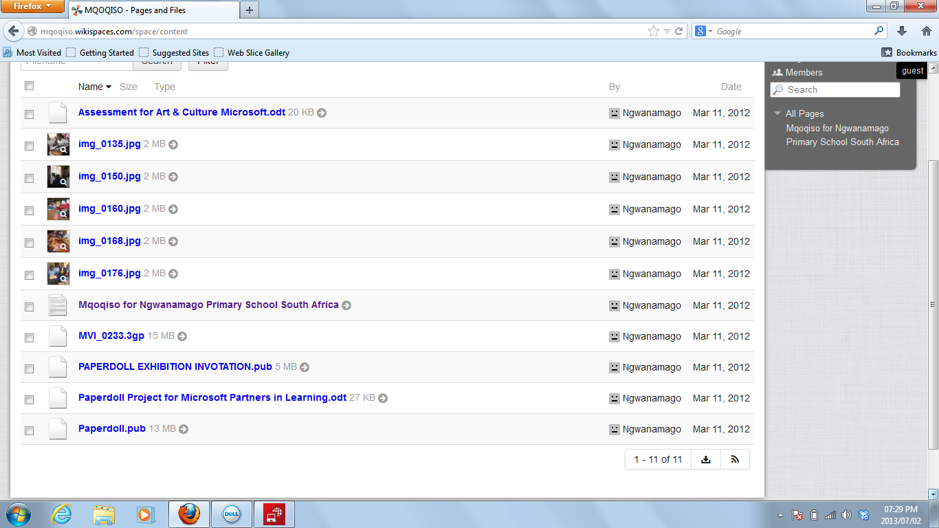

Slide 16
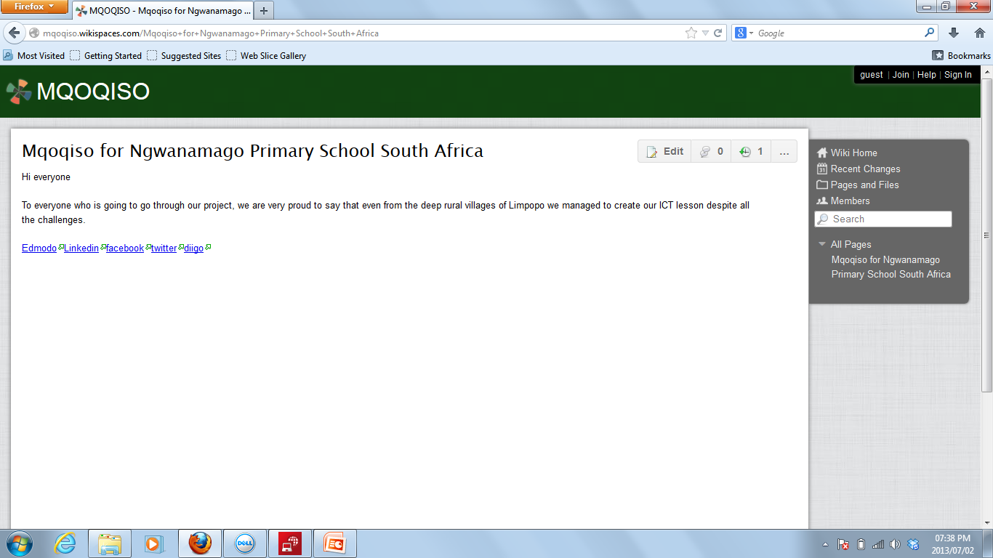

Slide 17
PROJECT ...... (MUSIC MIMING & SINGING) 2013
This is our lifeskill project and we aiming to produce more talents on it. ../MICROSOFT%20PARTNERS%20IN%20PROJECT%202013.pptx
PARTNERS IN LEARNING_AutoCollage_21_Images.jpg.
Most of the time i have to improvise because there are no policies in place.
We do our projects in the afternoon when everyone else has gone home and the learners are so co-operative they love what they do with me.

Slide 18
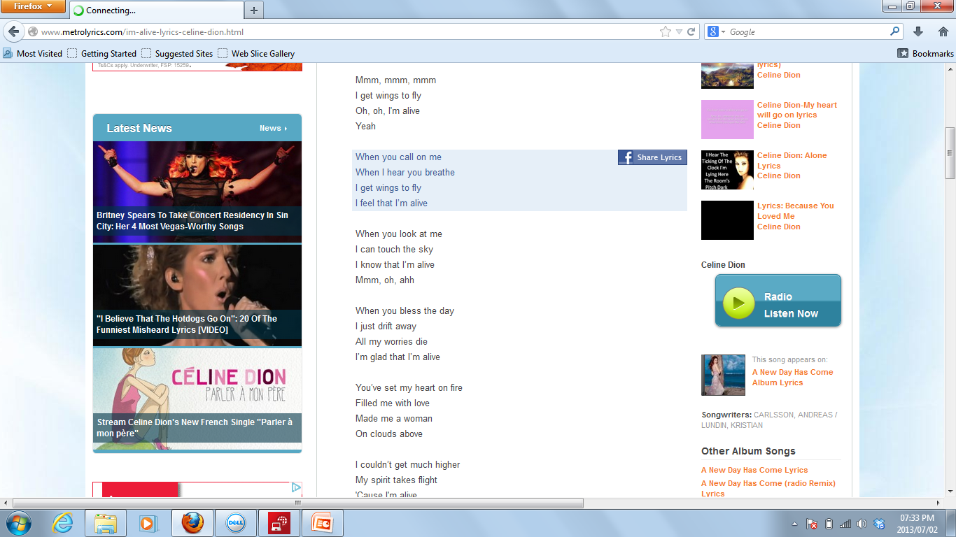

Slide 19
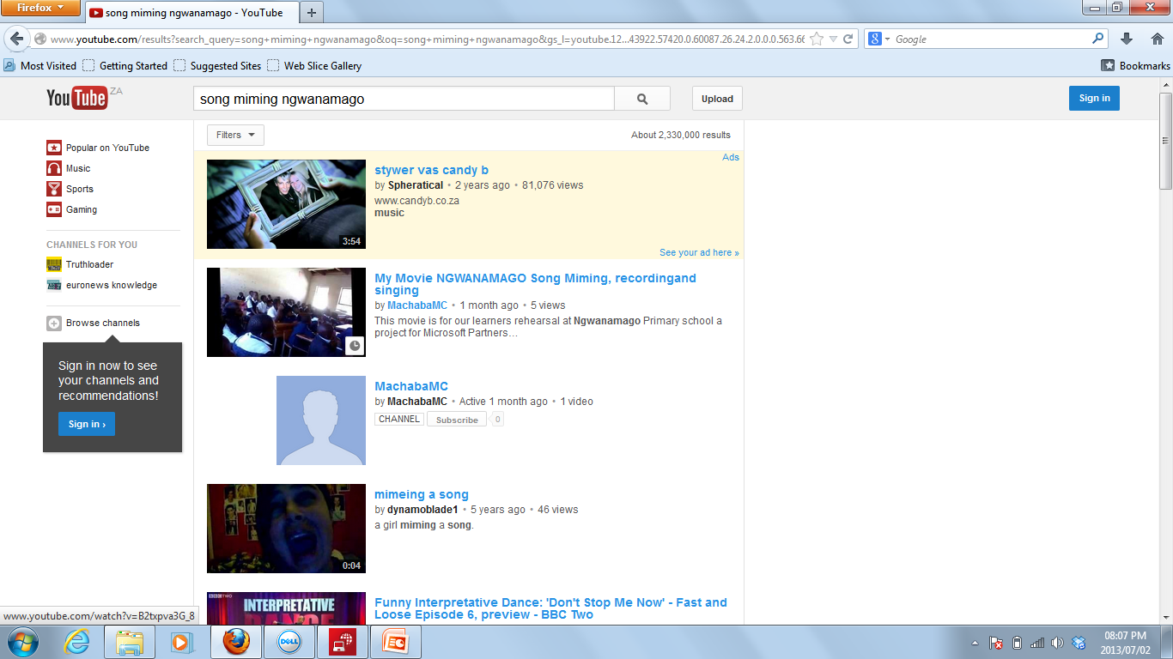

Slide 20
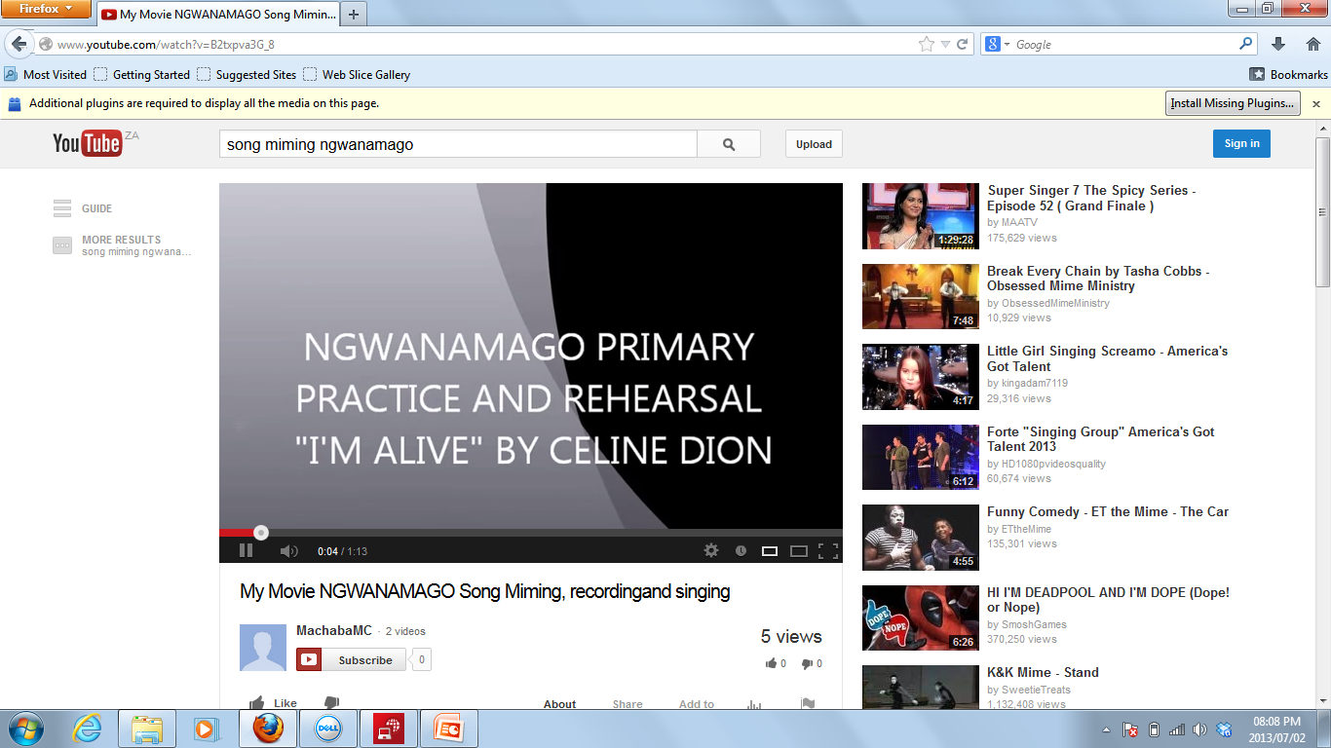

Slide 21
PEER COACHING AND ADMINISTRATIVE WORK.
Whenever there is a need for the work to be done either administratively or the one educator need help on ICT I do teach them and show them how things are done around.
Presentations for the principal, lesson plans, assessment tools, file dividers Tests you name them.
As I am presenting now there are computer lessons with the university of Limpopo for educators and nurses, so from my school seven educators are attending. I got the information very late but I improvised my own resources to register for all of them.

Slide 22
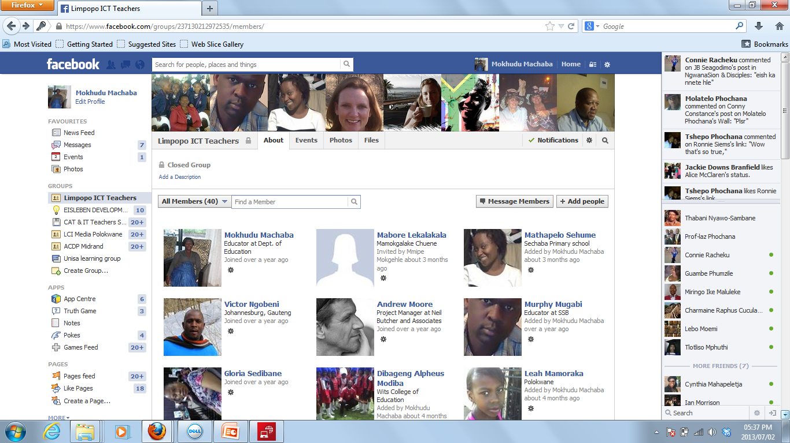

Slide 23
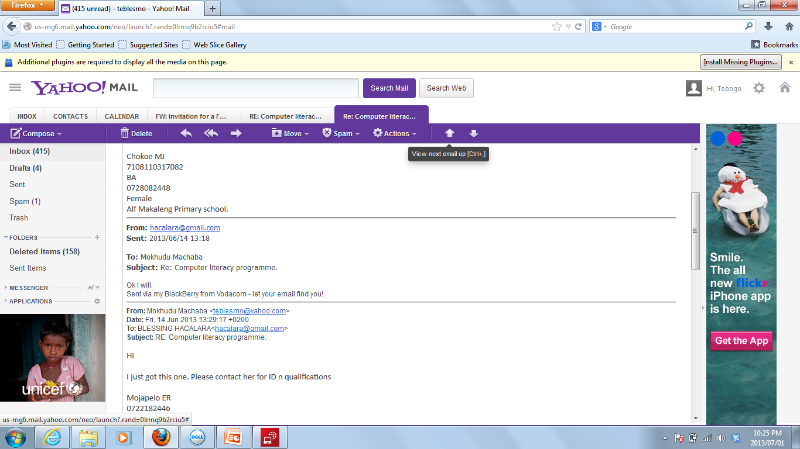

Slide 24
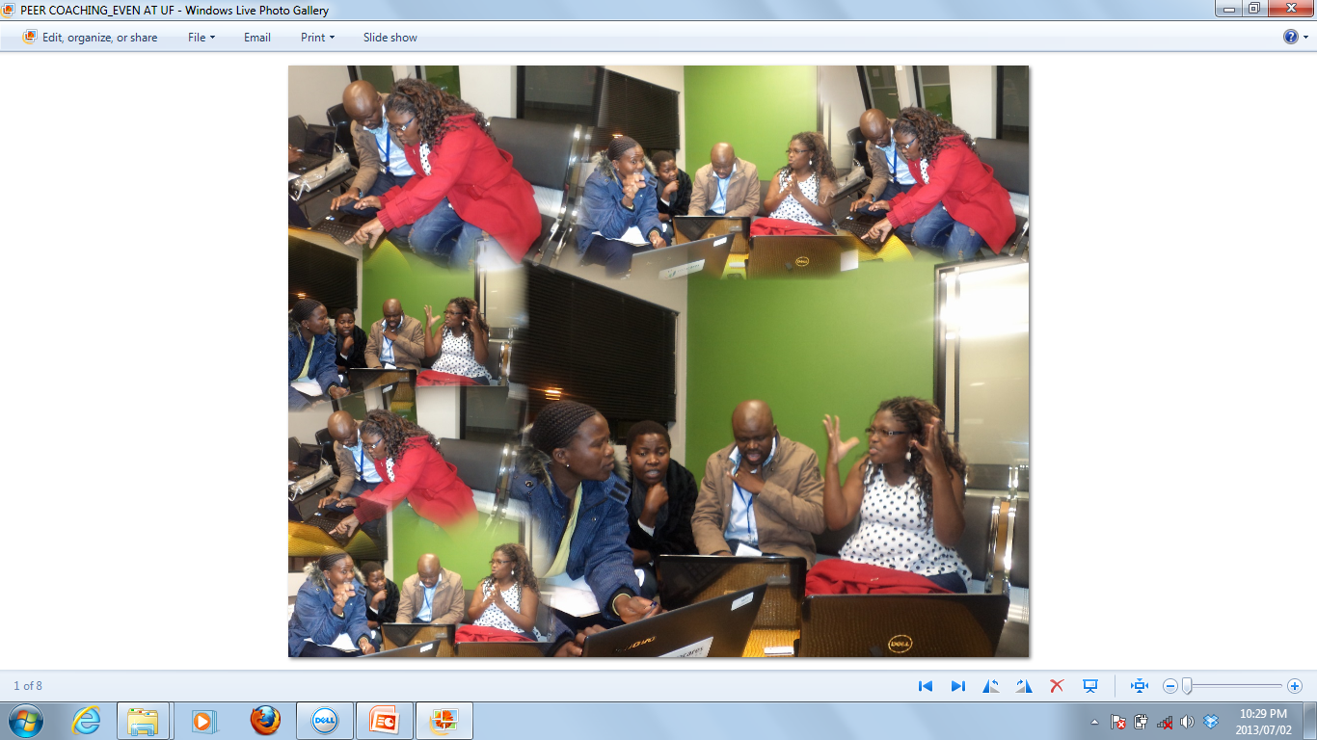

Slide 25
SAMS
Although I am not recommended to go to the workshops for this program when they get stuck along the way as an ICT educator I come in to help.
This term there was crisis because the circuit needed the schedule on this program and there seemed to be no way forward.
I asked the management to take work home so I can enter learners marks, it was Wednesday night on Friday they got their reports. For the first time I was given a recognition that indeed I am a ICT educator../../Pictures/sams.jpg

Slide 26
A TEACHER IS A TEACHER EVERYWHERE
Thanks to my church pastor who supports the vision I have of starting computer lessons at church as a community project
We also help community FET pupils with extra lessons. The church bought the Matric Uploaded CD’s for different learning areas.
Learners are attended to for monotoring every Saturday
../../Pictures/AutoCollage/community%20projects.jpg

Slide 27
TIPS FOR YOUR SUSTAINABILITY
PERSEVERE
LEARN FROM OTHERS
PLAN THE POSSIBLE
MONITOR AND EVALUATE EACH STEP OF THE PROCESS
BE COSULTATIVE
BE ACCOUNTABLE
BE TRANSPARENT
BE FAIR
COMMUNICATE
MAINTAIN WHAT YOU KNOW AND BE CONSISTENT

Slide 28
RECOMMENDATIONS
For this initiative to be successful, we need full support of the department to endorse the policies from above for ICT.
Since our learners are learning better with technology we have to consider and nurture this interest.
Governing bodies and management to take into consideration when buying LSTM to include ICT materials
Schools to have hired technicians for the smooth running of ICT in schools.
Schools to recognise and take into consideration peer coaching and collaborate with nearby schools to learn more on ICT.
South Africa to have organisation such as Naace were all stake holders will come together and discuss policies affecting ICT in the country.

Slide 29
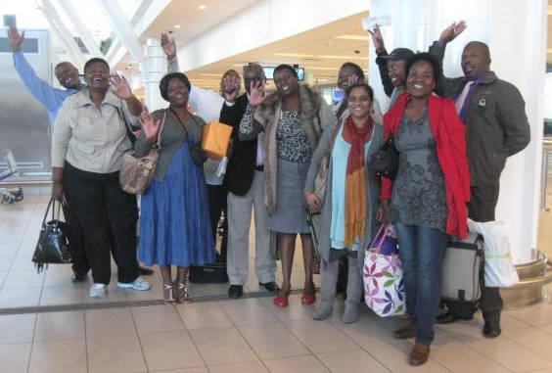
I THANK YOU ALL FOR YOUR ATTENTION
APPRECIATIONS ALSO GOES TO Microsoft PIL and SchoolnetSA. To my mentor Avuxeni, Coza Cares, Uniforum, Netday, ISPA I say thank I walked this route because you were just there

