Slide 1

THE NEW ERA OF
PRODUCTIVITY
is here and now …
ARE YOU READY?
Do not be left out!

Slide 2

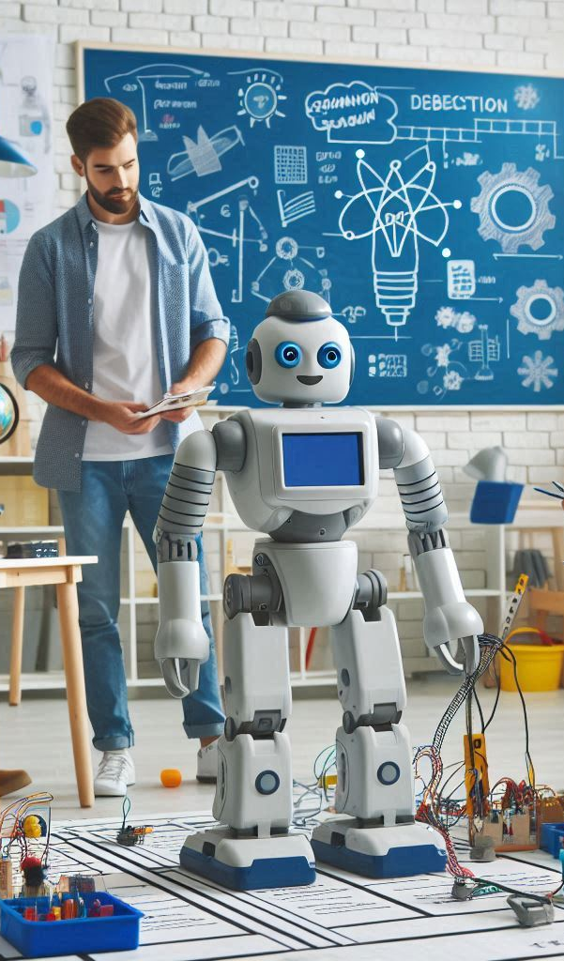
AI ------ in less than 5 years
1. Human life will speed up.
2. Behaviors will change.
3. Industries will be transformed
4. Everything will change.
Do not be obsolete! Hurry!

Slide 3
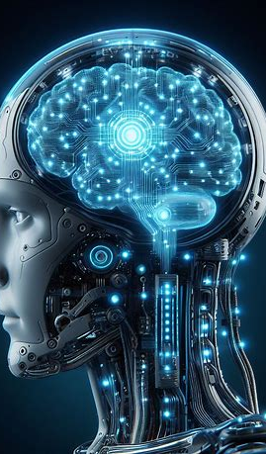
History of Ai
TASK One
Read more on history

Slide 4
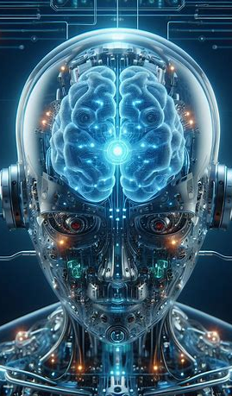
AI - Acronym and definition
Artificial intelligence (AI) is the intelligence of machines or software, as opposed to the intelligence of
humans or animals.
Purpose
to organize the world's information
make it readily accessible and useful.
Open AI
Aimed at developing safe and beneficial to all
AI requires people from a wide range of disciplines and backgrounds.

Slide 5

AI Principle
AI is simply a component of the technology, such as machine learning.
AI requires a foundation of specialized hardware and software for writing and training machine learning algorithms.
AI systems work by
Ingesting large amounts of labeled training data
Analyzing the data for correlations and patterns, and using these patterns to make predictions about future states.
New, rapidly improving generative AI techniques can create realistic text, images, music and other media.

Slide 6
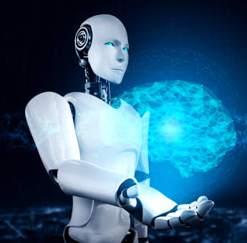
AI programming cognitive skills
1. Learning. AI programming focuses on acquiring data and creating rules, (algorithms), provide computing devices correct instructions on how to complete a specific task.
2. Reasoning. - choosing the right algorithm to reach a desired outcome.
3. Self-correction.- continually fine-tune algorithms and accurate results.
4. Creativity. This aspect of AI to generate new images, new text, new music and new ideas.

Slide 7
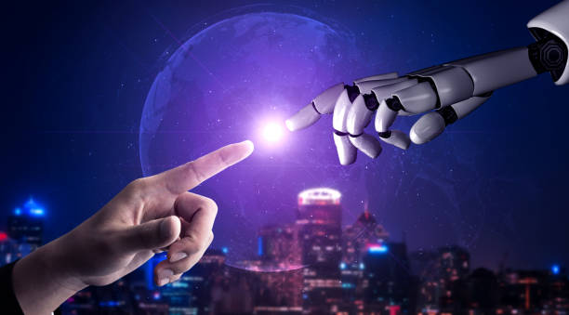
advantages of AI.
Good at detail-oriented jobs. Helps doctors at diagnosing certain cancers (breast cancer).
Reduced time for data-heavy tasks - used in data-heavy industries, including banking and securities, Financial services, AI to process loan applications and detect fraud.
Saves labor and increases productivity e.g. the use of warehouse automation, which grew during the pandemic (COVID 19).
Delivers consistent results in businesses -the ability to reach customers in their native language.
Improves customer satisfaction through personalization of content, messaging, ads.
AI-powered virtual agents are always available. AI programs do not need to sleep or take breaks, providing 24/7 service.

Slide 8
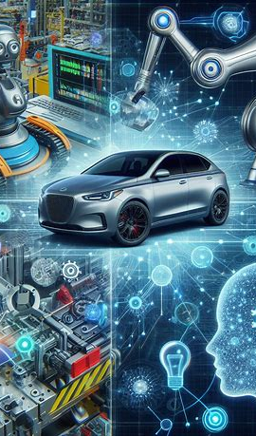
Disadvantages of AI
Expensive.
Requires deep technical expertise.
Limited supply of qualified workers to build AI tools.
Reflects the biases of its training data, at scale.
Lack of ability to generalize from one task to another.
Eliminates human jobs, increasing unemployment rates.

Slide 9
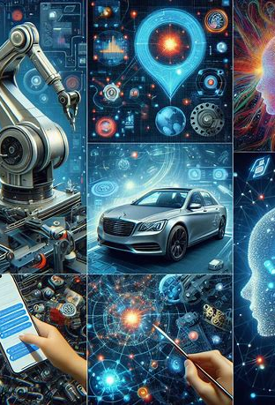
types of artificial intelligence?
Type 1: Reactive machines - AI systems with no memory and are task-specific.. used in chase game long ago.
Type 2: Limited memory - AI systems have memory to use past experiences to inform future decisions….. Like self-driving cars.
Type 3: Theory of mind - the system with social intelligence to understand emotions.
Type 4: Self-awareness - AI systems have a sense of self (consciousness).

Slide 10
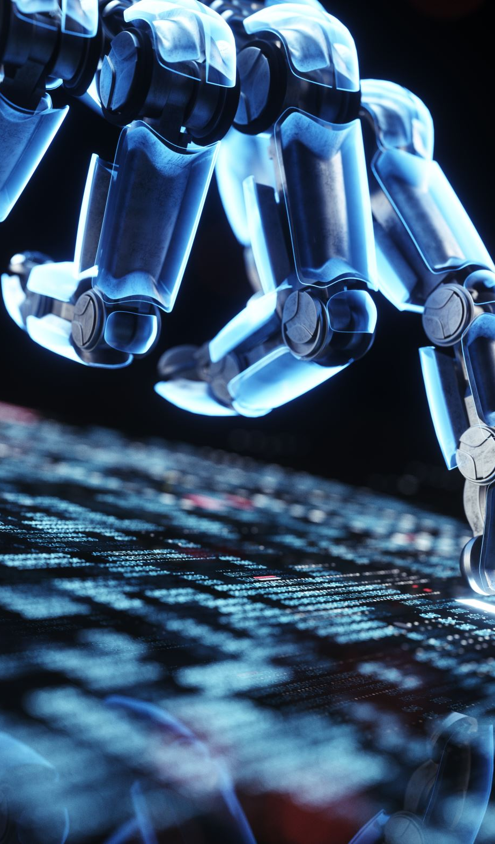
AI examples of technology
Automation to expand the volume and types of tasks performed e.g. robotic process automation (RPA), a software that automates repetitive, rules-based data processing tasks traditionally done by humans.
Machine learning - science of getting a computer to act without programming. This include: Supervised learning , Unsupervised learning. , Reinforcement learning.
Machine vision. This technology gives a machine the ability to see to capture and analyze visual information using a camera, analog-to-digital conversion and digital signal processing.
Natural language processing (NLP)- processing of human language by a computer program.

Slide 11
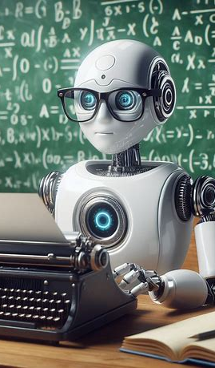
AI examples of technology
Robotics deals on the design and manufacturing of robots to perform tasks difficult for humans e.g. in car production or by NASA to move large objects in space.
Self-driving cars - use a combination of computer vision, image recognition and deep learning to build automated skills to pilot a vehicle while staying in a given lane and avoiding unexpected obstructions, such as pedestrians.
Text, image and audio generation. Generative AI techniques, which create many types of media from text prompts, are being applied extensively across businesses to create content.

Slide 12
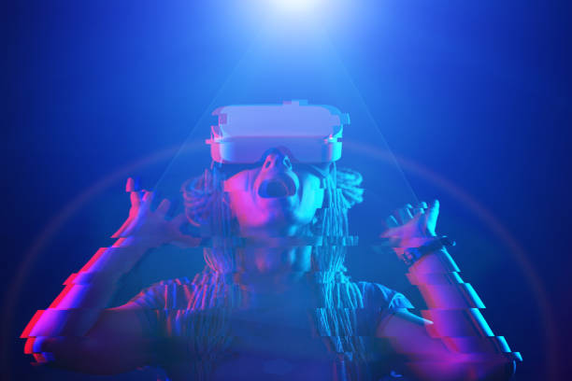
Application of AI
Healthcare- machine learning to make better and faster medical diagnosis.
Hine learning
Business – integration into analytics and customer relationship and immediate service
Education – automate grading, assess students and their needs,
Finance – programs (Intui/Turbo Tax and IBM (in purchasing homes)
Law – automate legal industry labour intensive recess

Slide 13
Application of AI
Entertainment – in advertising, making movies, creating scripts proof reading (media houses) quick
Software coding and IT processes – Generate AI tools and automate processes like data entry, fraud detection, customer service and security
Security – to provide alerts to new and emerging attacks quickly than human beings
Manufacturing – use of robots into workflow
Banking – employing to make customers aware of services and offerings to handle transactions
Transportation e.g. manage traffic, predict delays and ocean shipping efficiency.

Slide 14
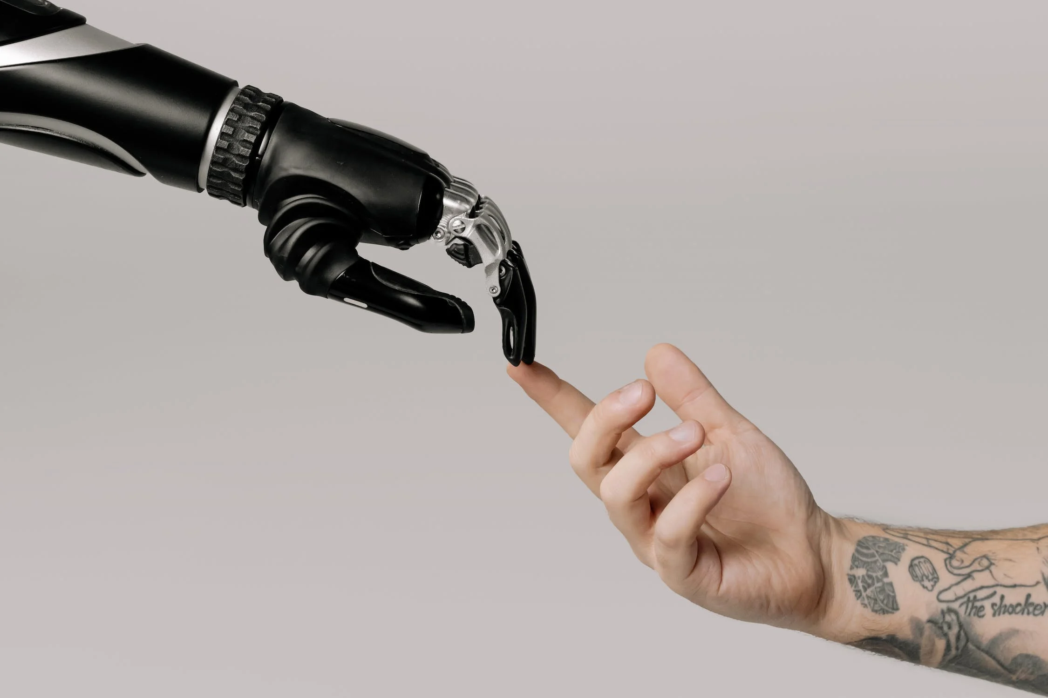
Ethical use of Ai
AI reinforces what it has already learnt.
Bias due to improperly trained algorithms and human bias.
Misuse due to deep fakes and phishing.
Legal concerns, including AI libel and copyright issues.
Elimination of jobs due to the growing capabilities of AI.
Data privacy concerns, particularly in the banking, healthcare and legal fields.

Slide 15
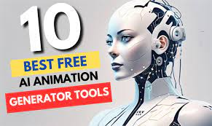
Student’s Best AI TOOLS - EDUCATION
Tool | Use
1. perplexity.ai | Research Assistant
2. nissab.ai | Calculate anything
3. otter.ai | Automate Notes
4. stepwisemath.ai | Math Teacher
5. scholarcy.com | Article Summarizer
6. caktus.ai | Study Tool
7. textero.ai | Generate Presentation
8. plaito.ai | Personal Tutor
9. Tome App | Generate presentation
10. Jenni AI | Write Papers
Aithor .com (for anything) and Lumen5 videos)

Slide 16
Student’s Best AI TOOLS - EDUCATION
Tool | Use
11. chatdoc.com | Chat with documents
12. neyscience.ai | Research Assistant
13. wisdolia.ai | Flashcard Generator
14. duolingo.ai | Learn Language
15. knowji.com | Learn Vocabulary
16. quillbot.com | Grammar Check
17. consensus.app | Extract Answers
18. knewton.com | Adaptive Learning
19. grammarly.com | Plagiarism Checker
20. cookai.chat | Chat with Books

Slide 17

facilitator’s Best AI TOOLS - EDUCATION
Tool | Use
1. Gemini | Solves anything
2. Adobe Firefly | Text to image
3. Heygen | Create AI avatar
4. Midjourney | Create Art
5. Topview AI | Video Editing
6. Pika 1.0 | Text to image
7. Logo Diffusion | Creates logo
8. Uiverse | Creates interface
9. Tome | Creates copycats
10. Jenni AI | Essay assistant
11. Zappier | Repetitive tasks
12. Eleven Labs | Copies your voice
13. Bard | Ask, essay, poems
14.Ask AI | Answers anything asked

Slide 18
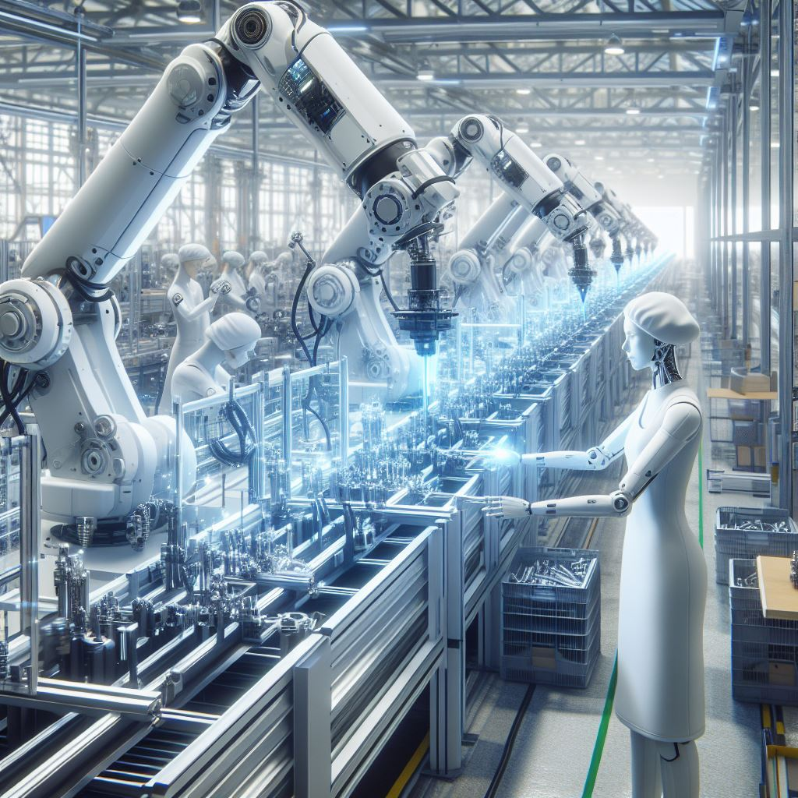
facilitator’s Best AI TOOLS - EDUCATION
Tool | Use
15. Quillbot | Rewrites anything
16. Autodraw | Drawing assistant
17. Addy Ai | Write any email
18. Wordtune | Summarizes notes
19. Soundraw AI | Generate cute songs
20. chatGPT | Automate tasks (instant answers)
21. Getyn AI | Convert voice to text
22. Designrr | Create ebooks, workbooks
23. Loggy.Art | Graphic design, social media posts
24. DesignBeast | Graphics and animations
25. Appie pie | Create apps in two minutes.
27. Nerd AI | writing, problem-solving, language learning
26. Other tools | Powtoon, Biteable, Opentoonz, Blender-to create animated videos

Slide 19
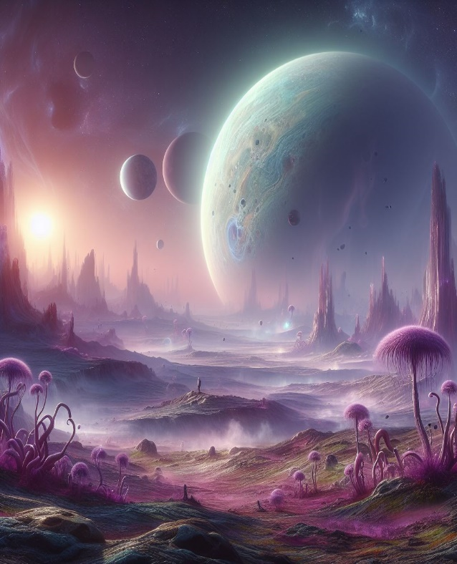
facilitator’s Best AI TOOLS - EDUCATION
Tool | Use
1. Jasper AI | Write anything
2. Kickresume | Create resume
3. Aithor.com | Write anything
4. Suno. Ai | Composes songs
5. Copilot | Does many tasks
6. Yep.so | Build landings page 2 Min
7. Axiom. Ai | Browser Automation
8. AI excel Bot | Generate Excel formula
9. Pencil | Marketing
10. Notion | Note taking
11. Eleven Labs | Copies your voice
12. ChatBot | Generates quick answers
13. Unriiddle AI | Faster Research
14. Tl;dv | Meeting (Google meet, Zoom, Teams

Slide 20
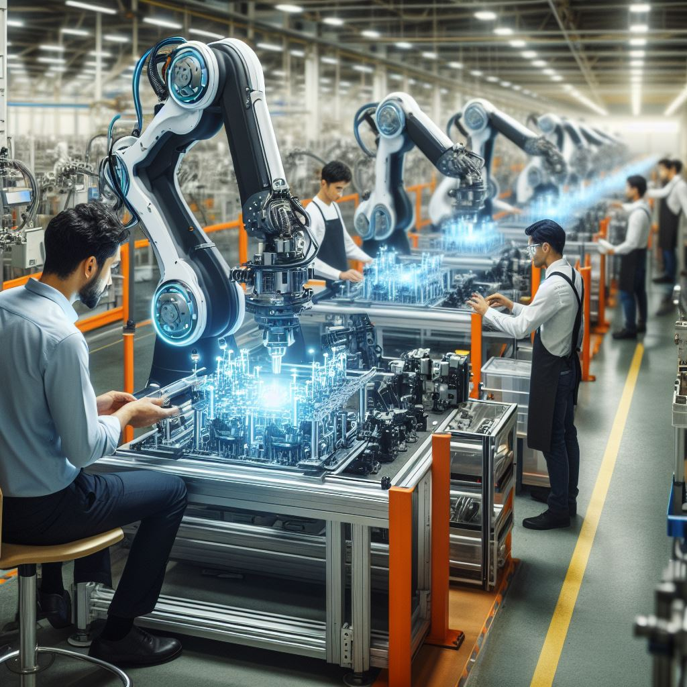
Best AI TOOLS - EDUCATION
Tool | Use
1. Copy AI | Writes anything
2. Kaiber | Creates videos
3. fliki | Create reels
4. Fireflies | Note Taking
5. Munch | Video Editing
6. Synthesia | Create free Videos

Slide 21
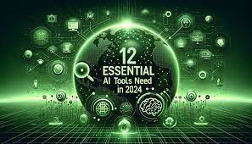
Best AI ALTERNATIVE TOOLS - EDUCATION
PAID | FREE | USE
1. ChatGPT | 1. Google Bard | Writing
2. Notion AI | 2. Otter | Notes
3. Midjourney | 3. Leonardo | Images
4. Canva AI | 4. Microsoft Designer | Design
5. OpusClip | 5. Topview | Video Editing
6. Simplified | 5. TomeAI | Presentation

Slide 22
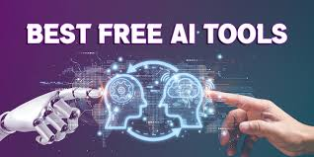
Classification of AI TOOLS
Music Tool | Daily Life Tools | Chrome Extensions | Productivity Tools | Chatbot Tools | Image Tools
Muzeek | Notion AI | Alicent | Berdeen AI | Yatterplus | StockIMG
2. Brain FM | Taskade | Compose AI | Paperpal | Typewise | Midjourney
3. Melodrive | TLVD | Poised AI | Consensus AI | Quickchat | Leonardo AI
4. Amper | Vandy AI | Vaila AI | Writesonic | Cohere | Bing AI
5. Jukedeck | Berdeen AI | Wiseone | ChatGPT | Kaizan | Autodraw
6. Boomy | Eesel | Final Scout | Scholarcy | GPTBuddy | Microsoft designer
7. Suno AI

Slide 23
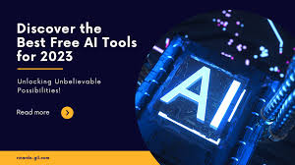
Classification of AI TOOLS
Sales Tools | Coding Tools | Platform X (Twitter) | You-Tube Tools | Writing Tools | Content Creation Tools
1. Lavender | 10WEB | Postwise | Eightify | AISEO | Writesonic
2. Warmer | Durable Ai | TweetHunter | Steve AI | Quillbot | Tome AI
3. Octone | Deepcode | Tribescaler | Glasp | Simplified | Beautiful AI
4. Twain | Akkio | Tweetlify | ClipMaker | Writesonic | ChatGPT
5. Regie | Replit | Tweetmonk | TubeBuddy | Bertha AI | Chat ABC
6. Simplified | GitHUb Copilat | Hypefury | Thumbly | Jasper AI | Steve AI

Slide 24
Special thanks
To Stock images (free images).
Google.
Ai.
The pictures and images do not belong to me (I have no rights).
Thank you Stock , Google and Ai.

